Slide 1
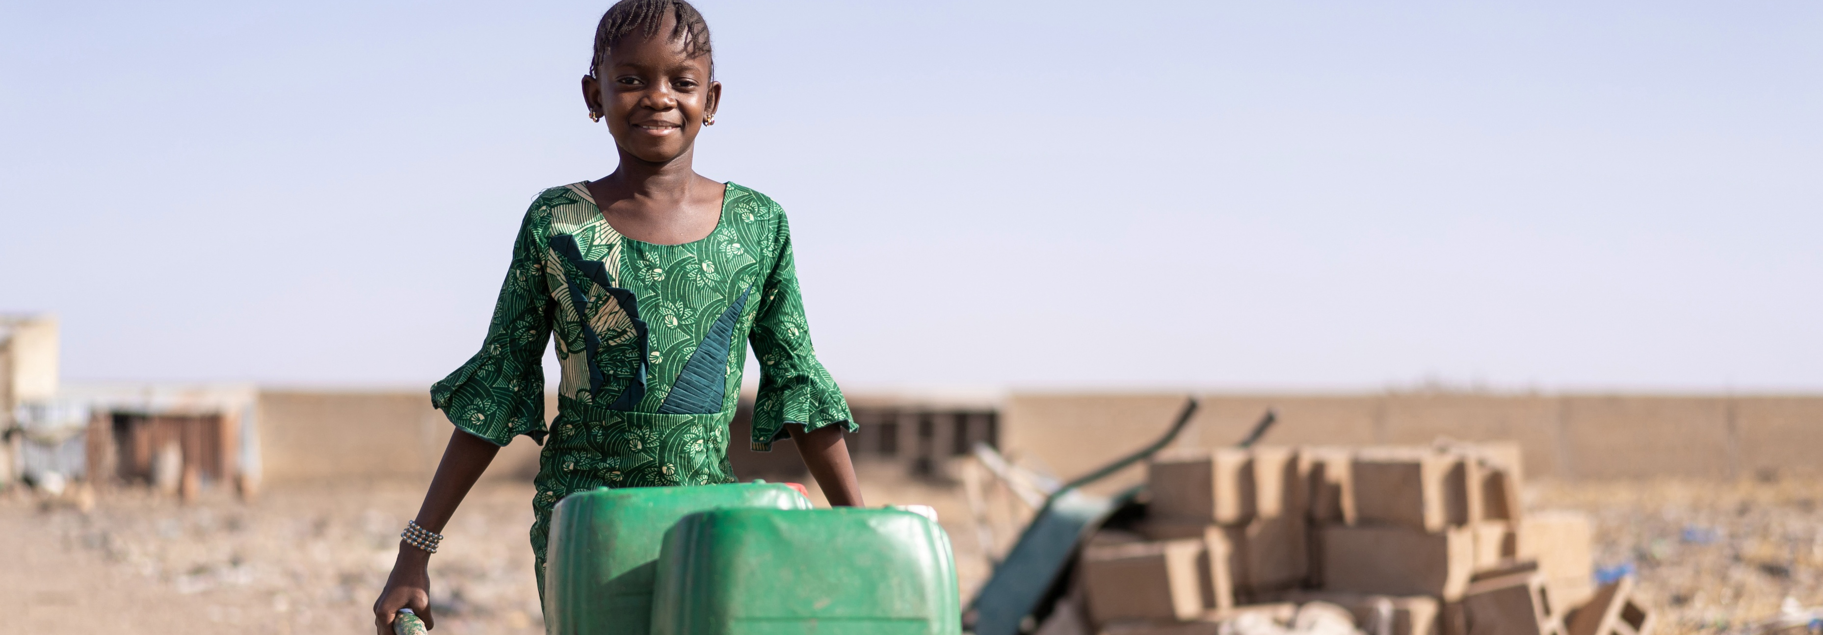



Baseline financial trends analysis
Water Rights Tracker
Dr Albert Edgar Manyuchi
October 2026

Slide 2
Baseline financial trend analysis
Most of the indicators in the profiles are point indicators
However, our financial analysis included trend analysis showing changes over time
The analysis focused on the period between 2021 and 2025
The financial analysis variables are budget sufficiency, budget coverage, revenue collection rate, capital budget allocated to renewal of existing assets and maintenance spending rates.
The analysis was not exclusive to water only but assessed the overall available budget data

Slide 3
Examples of the financial trend analysis done
Budget Sufficiency
Revenue Coverage

Slide 4
Examples continued
Revenue collection rate
Capital budget allocated to renewal of existing assets

Slide 5
Examples continued
Revenue collection rate
Capital budget allocated to renewal of existing assets

Slide 6
Examples continued
Maintanence spending rate

Slide 7
Key findings
For most municipalities, the total budgeted revenue exceeds by a slight margin the total budgeted expenditure, demonstrating marginal budget sufficiency over the period
The revenue coverage shows marginal changes over time as grants and transfers compliment municipal own revenue
The revenue collection rate show significant variations over time for most municipalities. However, preliminary findings indicate that the revenue collection rate has been declining over time for several municipalities
Capital budget allocated to renewal of existing assets also shows significant variations over time. However, this variable has the most data gaps across most municipalities
The maintenance spending rate shows that reduced expenditure for maintenance over time for most municipalities. This is happening over a backdrop of increased recorded evidence of ageing infrastructure across many municipalities

Slide 8

Thank you
Please send comments to albertedgar.manyuchi@wits.ac.za

